Slide 1
Oral Hypoglycaemic Agents
Dr Anuradha Dassanayake
Department of Pharmacology

Slide 2
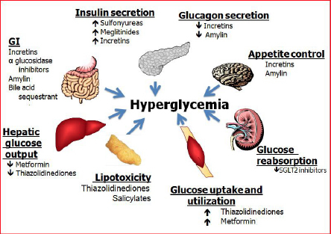

Slide 3
Metabolic syndrome-Lifestyle modifications
Insulin resistance
  Energy excess
  Sedentary lifestyle
Lipotoxicity/Adipose tissue dysfunction
  Ectopic fat
Genetics
Gut Dysbiosis
  Changes in the GUT micribiome resulting from poor eating habits
    Fructose
    Satutatedfoods/Fast foods

Slide 4


Slide 5


Slide 6
Oral Hypoglycaemic Agents
Sulphonylureas
Biguanides
Alpha glucosidase inhibitors- Acarbose
Ripaglinide
Glitazones
Gliptines

Slide 7
Sulphonylureas
In use since 1954
Activates receptors on the beta cells of the pancrease to release stored insulin
Do not increase insulin secretion.
Enhances Insulin action on the liver, muscle and adipose tissue.
Reduces hepatic glucose output and increases glucose uptake in muscles.

Slide 8
Sulphonylureas Cont.
Ineffective in total Insulin defficient. No place in the management of Type 1 diabetes
Causes hypoglycaemia in normal subjects and in diabetics.
Should not be used in pregnancy and breast feeding.

Slide 9
Sulphonylureas- Individual drugs
Tolbutamide- t1/2 8hrs
Glibenclamide- t1/2 10 hrs
Chlorpropamide t1/2 36 hrs
Gliclazide
Glipizide
Glimepiride

Slide 10
Tolbutamide
Short acting
Metabolised in the liver
Safer in patients with renal impairement
Safer in elderly

Slide 11
Glibenclamide
Widely used
Has intermediate kinetics
Can be given as a single daily dose
Started with a daily dose of 5mg in the morning before breakfast
Max dose is 15 mg/day

Slide 12
Chlorpropamide.
Longer duration of action
Risk of prolonged hypoglycaemia
Should not be used in elderly

Slide 13
Glimiperide
Truly once a day sulphonyluria
Second generation sulphonylurea

Slide 14
Side effects of Sulphonylureas
Hypoglycaemia
Allergic reactions
Weight gain

Slide 15


Slide 16


Slide 17


Slide 18
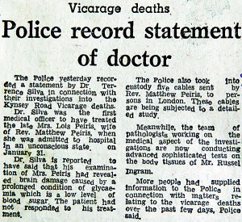

Slide 19


Slide 20
Deliberate poisoning with insulin/OHG
Reported
Rare

Slide 21
Drugs that will cause hypoglycaemia
All insulins
Sulphonylureas
Repaglinide
Others usually will not cause in healthy

Slide 22
Metformin
t1/2 is 5hours
Reduces the production of glucose in the liver
Inhibits gluconeogenesis
Enhances peripheral insulin sensitivity.
Do not act in the absence of insulin
Minor adverse reactions are common- Diarrhoea

Slide 23
Metformin cont.
Chief use is in obese patients with NIDDM
Metformin is not metabolised and excreted in the kidney.
Do not cause hypoglycaemia
Lactic acidosis is a rare serious side effect.
Max dose is 3g/day
Delayed release or extended release formulations are now available

Slide 24
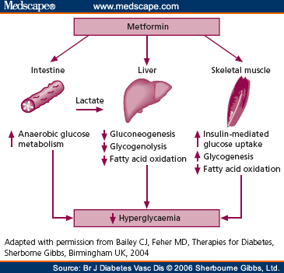

Slide 25
Acarbose
Alpha glucosidase inhibitor
Reduces digestion of complex carbohydrates
Slows absorption from gut
Abdominal discomfort is a problem
Can be combined with a Sulphonylurea.

Slide 26
Repaglinide
Stimulates insulin release
Short duration of action
Given shortly before a meal

Slide 27
Thiozoloidinediones (Glitazones)
Pioglitazone
Rosiglitazone
Reduces peripheral insulin resistance
Used in combination with metformin or a sulphonylurea
Liver function tests should be monitored
Weight gain & oedema is a significant side effect

Slide 28
Thiozolidinediones ct-
Use gradually reducing due to concerns with safety

Slide 29
Incretins
Group of hormones that reduces blood sugar levels
Incretins are released following a meal and augment the release of insulin from pancreatic beta cells
GLP1/GIP
In T2 DM release of these diminished PP-Low insulin /High glucagon
DPP-4 inactivates both
GLP-1 analogues are used in diabetes in the form of s.c injections
DPP-4 inhibitors are active orally

Slide 30
Sitagliptin/Vildagliptin
Dipeptidyl peptidase 4 (DPP-4) inhibitors
Inhibits the breakdown of GLP 1(Glycogen like peptide 1 )
GLP 1 enhances insulin secretion in response to raised glucose concentration.
No weight gain. No hypoglycaemic side effects
Used once day
Pancreatitis is a concern

Slide 31
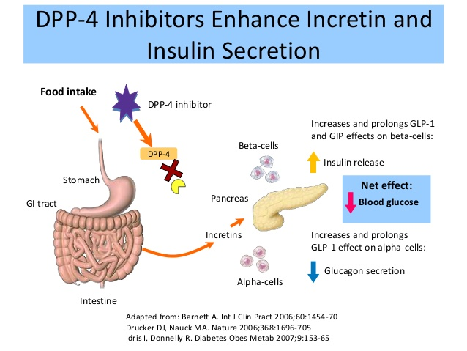

Slide 32
Glucagon like polypeptide-1 receptor agonists
Exetinide/Liraglutide
Injected subcutaneously
Weight loss is an advantage

Slide 33
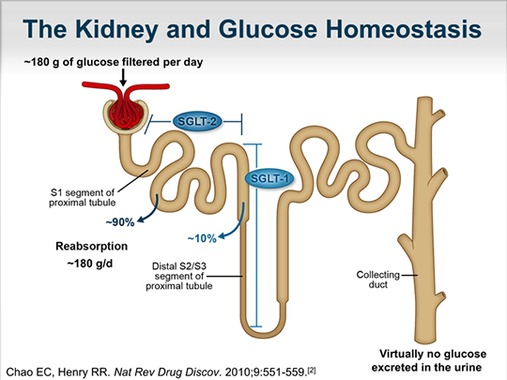

Slide 34
SGLT2 inhibitors
Empagliflozin
Blocks reabsorption of glucose in the kidney
Reduces weight
Increases the risk of urine ninfections

Slide 35
SGLT2 inhibitors
Empagliflozin
Blocks reabsorption of glucose in the kidney
Reduces weight
Increases the risk of urine ninfections

Slide 36
Combination therapy
In type 1 diabetes
In type 2 diabetes

Slide 37
Selection of therapy for diabetes
Diet alone
Diet plus oral hypoglycaemic agent
Diet plus Insulin

Slide 38
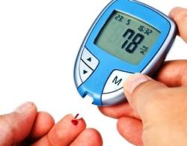

Slide 39
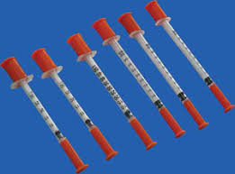

Slide 40
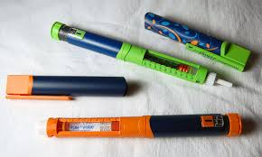

Slide 41


